Slide 1

MOBILE NETWORK AND SYSTEM SECURITY: VULNERABILITY AND THREAD MITIGATION SYSTEM
(ITA0302-MOBILE COMPUTING FOR CELLULAR SYSTEM OPERATIONS)
By
SK SHRIHASHINI (Reg. No: 192111021)
HARITHA.D (Reg. No: 192421282)
Under the Guidance of
Dr. K.SARAVANAN
SIMATS Engineering
Notes:
1
1

Slide 2
OUTLINE
Introduction
Problem Statement
Existing Methodology
Proposed Methodology
Literature Review
Overview of Network Dashboard
Testing & Result
Conclusion
References
Notes:
2
2

Slide 3
Introduction
Mobile App Security Ensuring mobile app security involves implementing measures like encryption, authentication, and secure coding to prevent cyber threats.
Vulnerability Weaknesses in mobile applications, such as insecure APIs, SQL injection, and XSS, can be exploited by attackers to gain unauthorized access or manipulate data.
Mitigation Using security best practices, regular updates, and threat detection mechanisms helps reduce risks and protect mobile apps from attacks.

Slide 4
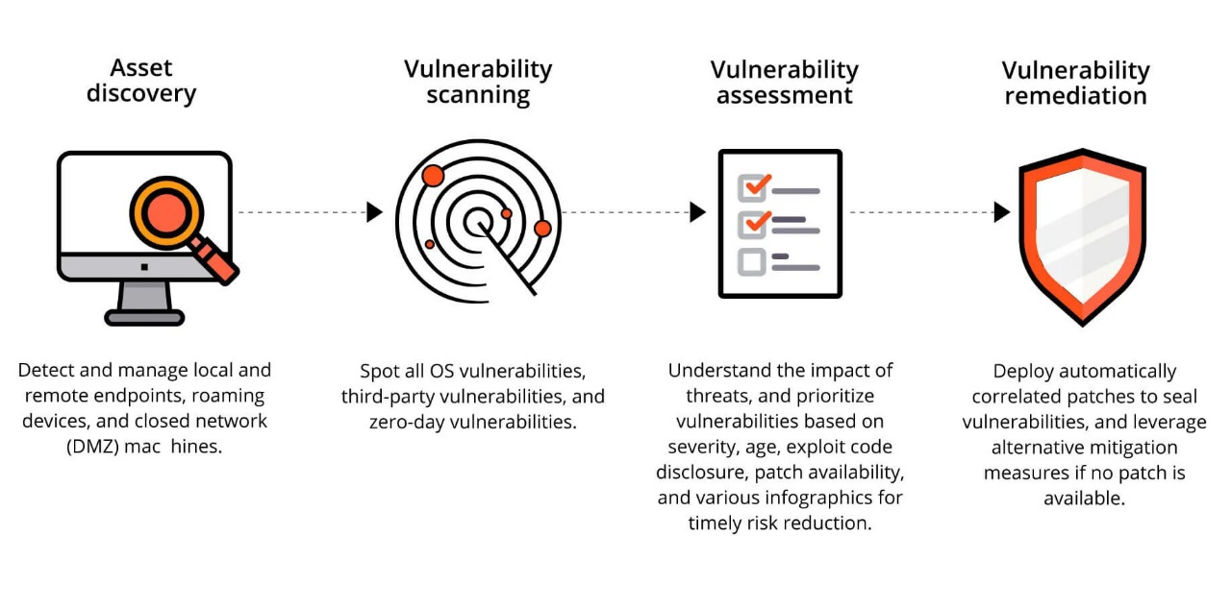
Vulnerability Management

Slide 5
Problem Statement
Limited Threat Detection – Manual security assessments often miss vulnerabilities, allowing attackers to exploit weak points in websites and networks.
Lack of Real-Time Monitoring – Traditional methods do not provide continuous scanning, making it difficult to detect threats as they occur.
Time-Consuming and Inefficient – Security audits require significant time and expertise, making them impractical for large-scale applications.
Ineffective Against Evolving Attacks – Cyber threats are constantly evolving, but traditional security measures struggle to adapt to new attack techniques.

Slide 6
Existing Methodology Drawbacks
Lack of Real-Time Adaptation
Ineffective against zero-day and dynamic threats.
Performance Overhead
Security methods slow down applications.
Emerging Attacks
Does not fully cover new threats like SSRF and AI-driven attacks.
False Positives
Automated tools still require manual verification.
User Awareness
Limited focus on phishing and social engineering protection.

Slide 7
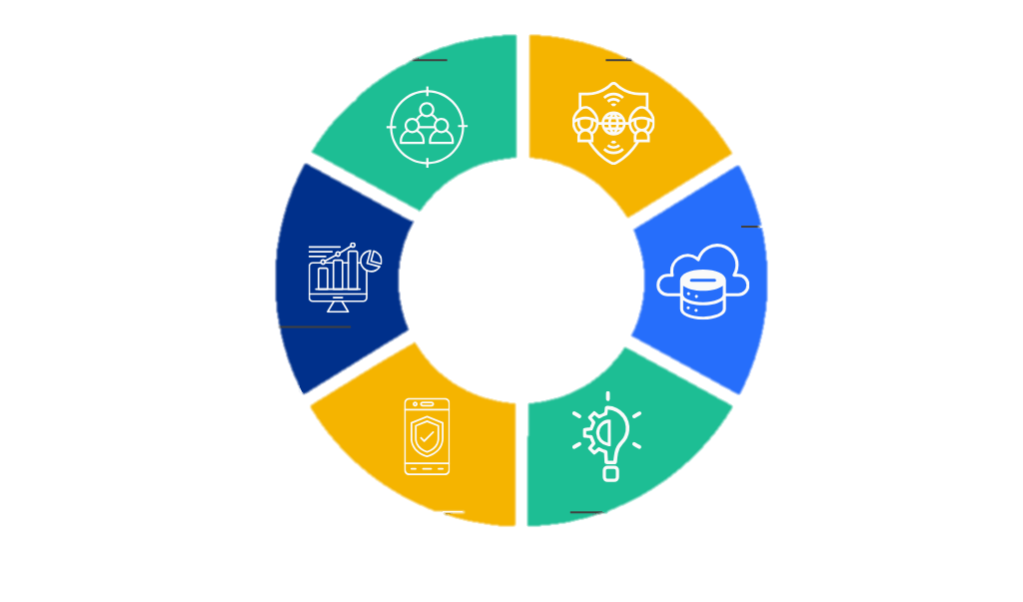
Proposed Methodology
Automated Website Security Scanner:
Scans websites for vulnerabilities.
Real-Time DHCP Analyzer:
Monitors DHCP traffic for anomalies.
Proactive Threat Detection :
Identifies threats before attacks.
Efficient and Scalable Security Audits :
Adapts security assessments to growth.
Security Logging for Forensic Analysis:
Records security events for investigations.
OpenNetwork Port Scanning:
Detects open ports for security risks.

Slide 8
Literature Review
Security Testing with Taint
Analysis
& Genetic Algorithms
(2017)
Enhances web security
testing using taint tracking .
Automated Removal of XSS Vulnerabilities -
(2018)
Detects and eliminates XSS
attacks automatically.
Mining SQL Injection and
XSS Vulnerabilities Using
Hybrid Analysis
(2019)
Detects SQLi and XSS with
hybrid program analysis.
Web Application Protection Techniques: A Taxonomy
(2020)
Classifies web security
techniques
Survey of SQL Injection
Detection & Prevention
(2021)
Reviews SQLi defense mechanisms.

Slide 9
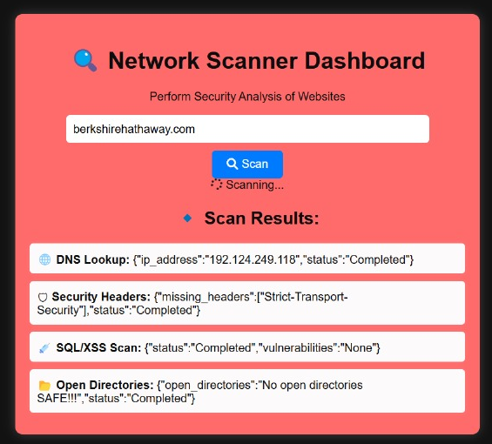
Overview of Network Dashboard
IP Address Manager Dashboard
Network Scanner Dashboard

Slide 10
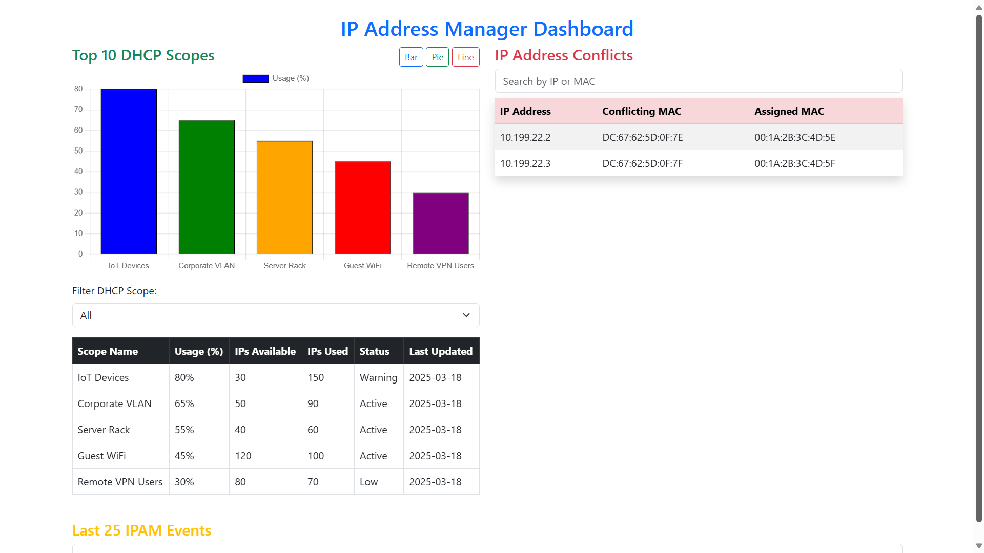
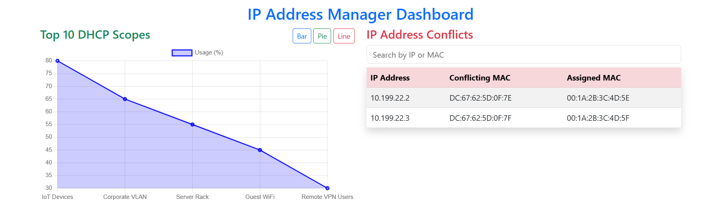
Overview of Network Dashboard

Slide 11
Workflow of URL security analysis and vulnerability detection process.
Start
Input from user an URL
URL sent to Scanner
Cookies Test, CSRF, XXS, DDOS
Session Expires, SQL Injection
Check if valid URL
YES
Get IP, URL, OpenPort,
Whoisdata
NO
Send Error message to web
Check/sort report according to vulnerabilities
Save Security Logs
End

Slide 12
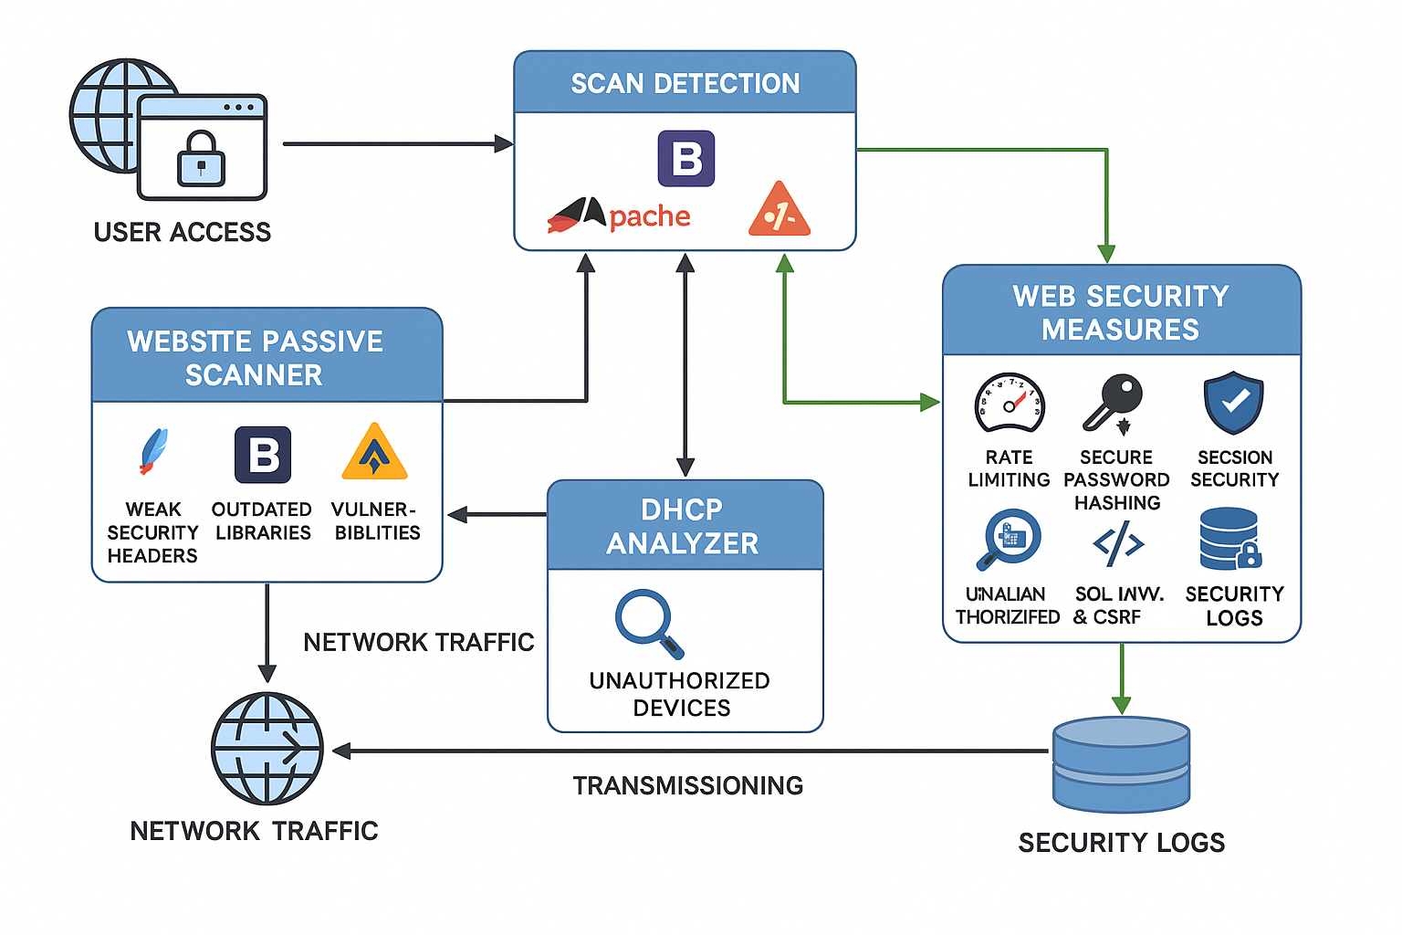
System architecture of security modules for threat detection and mitigation.

Slide 13
Conclusion
Reduced Vulnerabilities: the system effectively reduces the number of reported risks. Identifying and addressing weak security headers, outdated libraries, and unauthorized devices helps in minimizing potential attack vectors.
Stronger Security: The integration of security measures like rate limiting, secure password hashing, and session security enhances overall system resilience.
Layered Security: The system follows a multi-layered security approach, combining passive scanning, unauthorized device detection, and proactive security measures.
Continuous Monitoring: By continuously analyzing network traffic, detecting vulnerabilities, and logging security events, the system ensures real-time adaptation to emerging threats.

Slide 14
Reference
S. W. Boyd, G. S. Kc, M. E. Locasto, A. D. Keromytis, and V. Prevelakis, “On the general applicability of instruction-set randomization,” IEEE Transactions on Dependable and Secure Computing, vol. 7, no. 3, pp. 255–270, 2010.
K. Elshazly, Y. Fouad, M. Saleh, and A. Sewisy, “A survey of SQL injection attack detection and prevention,” Journal of Computer and Communications, vol. 2, no. 8, pp. 1–9, 2014.
A. Azfar, K.-K. R. Choo, and L. Liu, “A study of ten popular Android mobile VoIP applications: are the communications encrypted?” in Proceedings of the 47th Hawaii International Conference on System Sciences (HICSS ’14), pp. 4858–4867, IEEE, Waikoloa, Hawaii, USA, January 2014.
A. Azfar, K. K. R. Choo, and L. Liu, “Forensic taxonomy of popular Android mHealth apps,” in Proceedings of the 21st Americas Conference on Information Systems (AMCIS ’15), San Juan, Puerto Rico, August 2015.
A. Azfar, K. K. R. Choo, and L. Liu, “An android communication app forensic taxonomy,” Journal of Forensic Sciences, vol. 61, no. 5, pp. 1337–1350, 2016.

